Slide 1
FaceNet: A Unified Embedding for Face Recognition and Clustering
CVPR2015
Florian Schroff, Dmitry Kalenichenko, James Philbin
Google Inc

Slide 2
Present a learned system to map face images to points on a compact hypersphere Euclidean space, where the L2 distances of points represent the similarities of original face images.
Achieve state-of-the-art performance on face recognition, verification and clustering.

Slide 3
Traditional face recognition based on deep networks
Classification layer
Bottleneck layer
Downsides:
indirectness: may not generalize well on new faces
inefficiency: representation is very large

Slide 4
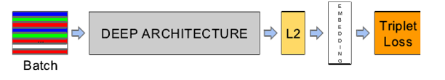
Biggest innovation of this paper
Make use of bottleneck layer – NO
Optimize embedding itself – YES
Goal:
Same identify – same point
Different identifies – different points
Squared L2 distance – face similarity

Slide 5
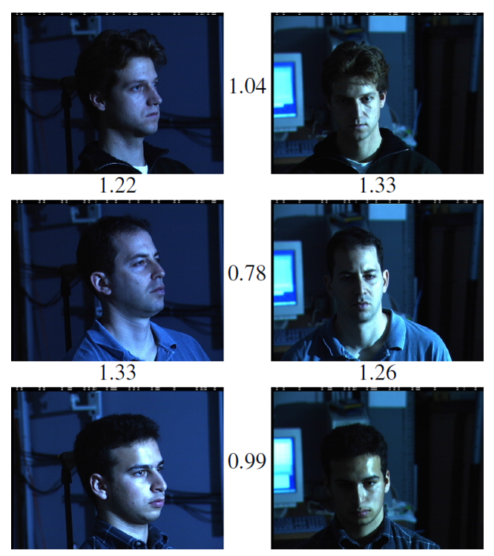
Different persons
Same person

Slide 6
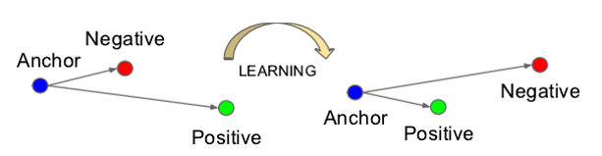
Triplet Loss
Input: three pieces of face images
Smaller distance between same identify
Larger distance between different identifies

Slide 7
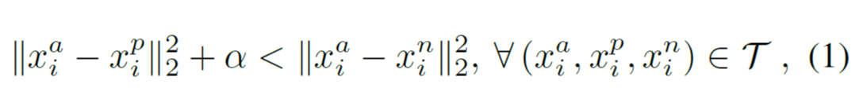
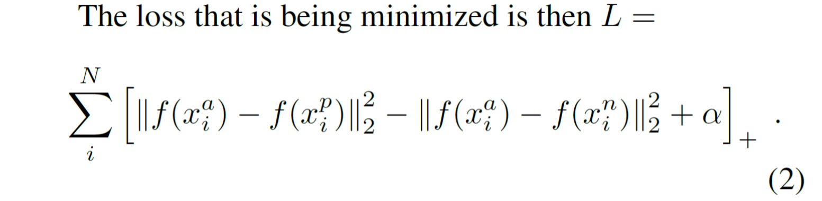
Triplet Loss

Slide 8


Triplet Selection
Why:
1000 identities with 20 face images for each identify
O(1000²) situations
How:
Hard positive: the most dissimilar image in another 19 images
Hard negative: the most similar image in another 999*20 images

Slide 9
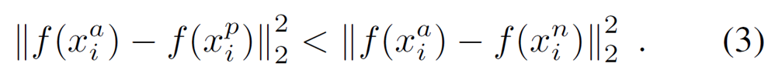
Triplet Selection
Method
Offline
Generate triplets every n steps
Use the most recent network chepoint
Compute argmin and argmax on a subset of the data
Online
Select the hard positive/negative exemplars from within a mani-batch
Practically adopted.
Use large mini-batch
Pick up all anchor-positive pairs
Pick up the hard anchor-negative pair

Slide 10
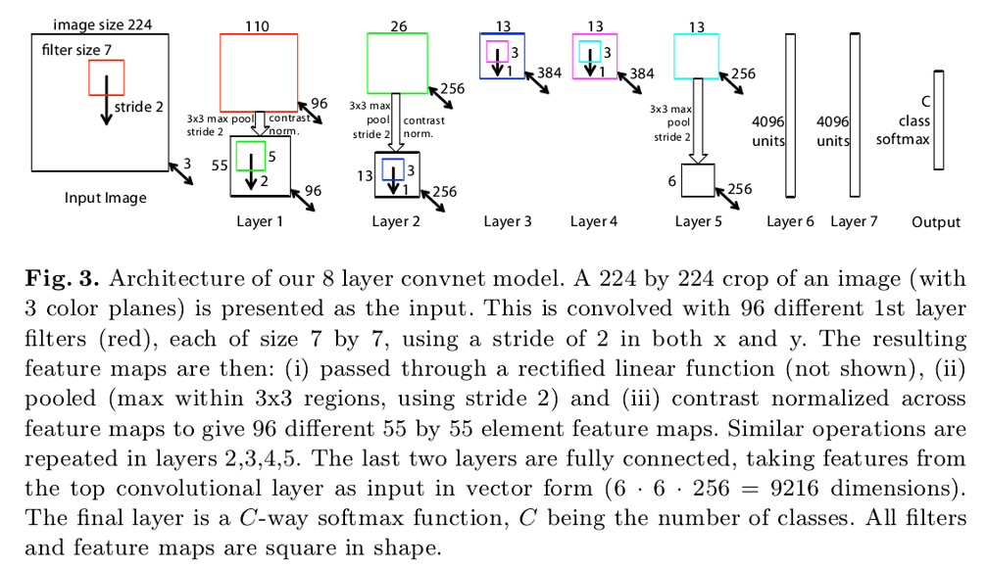
Deep Convolutional Networks
1. Based on Zeiler&Fergus model, additionally add several 1x1xd convolutional layers.

Slide 11
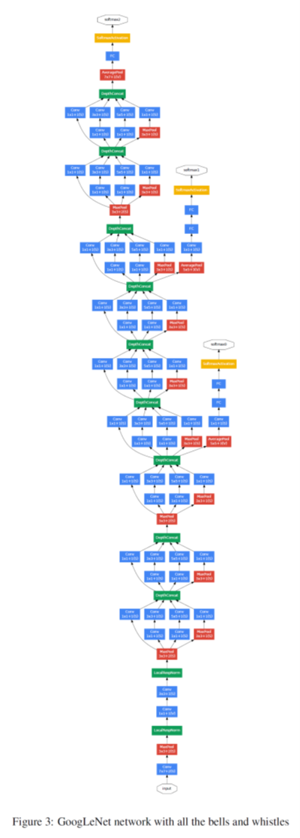
Deep Convolutional Networks
2. GoogLeNet
More layers with fewer
parameters

Slide 12
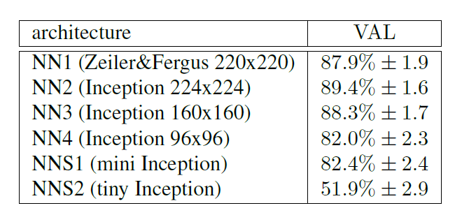
Experiment
FLOPS vs. Accuracy trade-off (VAL at 10e-3 false accept rate)

Slide 13
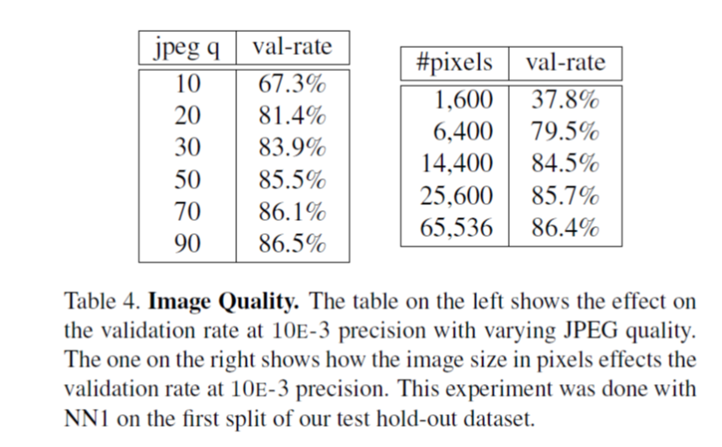
Experiment
Image quality

Slide 14
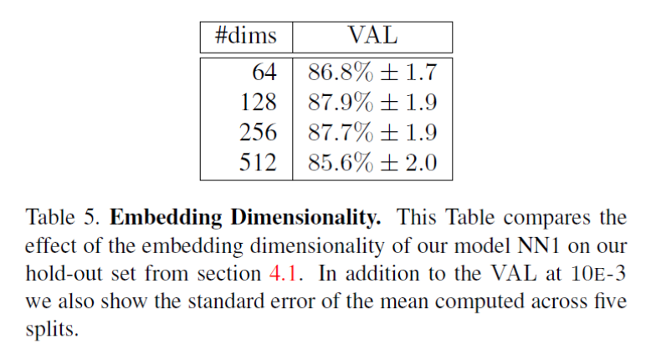
Experiment
Embedding Dimensionality

Slide 15
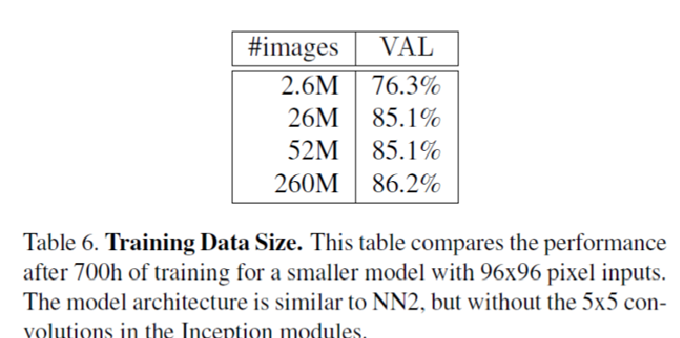

Experiment
Training Data Size

Slide 16
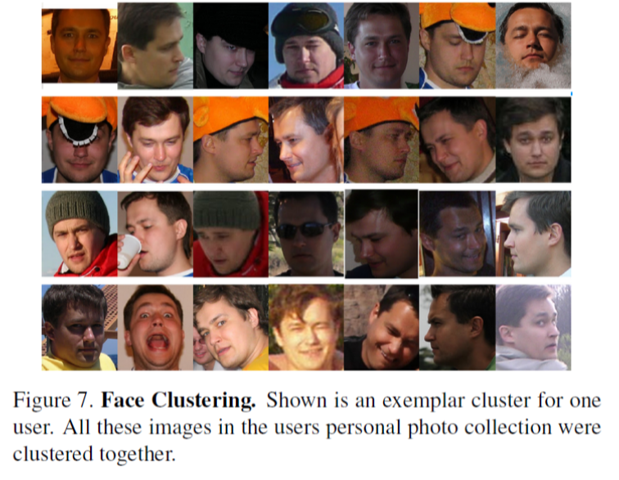
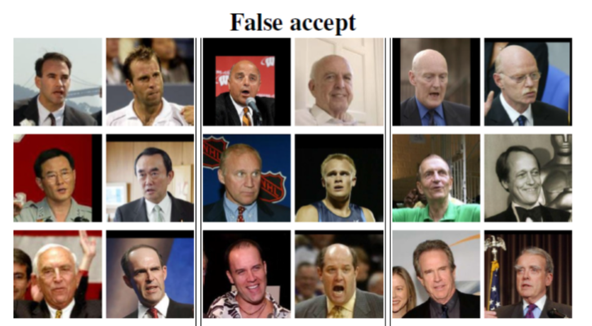
Face Clustering/Verification

Slide 17
Summary
New loss function
Sparse dimensional feature- 128 dimension
Achieve the best performance on public datasets
Require few pre-processings

